Slide 1
Deep Speaker Identification
Zhao guixiao

Slide 2
Concepts
Speaker identification
Deep speaker identification
Notes:
分为三个部分，第一部分介绍说话人识别的一些概念。
第二部分介绍传统的说话人识别（方法）I-vector
第三部分介绍深度说话人识别方法。

Slide 3
Concepts
Speaker recognition, also known as voiceprint recognition, is a widely used technology. The main application scenarios include access control systems and conference recording systems.
Speaker recognition tasks can be divided into two categories, one is speaker identification, which is a multi-category task. The other type is speaker verification, which is a two-category task.
Notes:
说话人识别也叫声纹识别，是一项目前应用较为广泛的技术。主要应用场景有门禁系统、会议记录系统等。
说话人识别任务可以分为两类，一类为speaker identification，也就是说话人辨认，从较多说话人中辨识出是哪一个说话人，为一个多分类任务。另一类为speaker verification，为说话人确认，判断是不是这一个说话人，为一个二分类任务。
今天要介绍的是前者，也就是speaker identification。

Slide 4
Concepts
Deep speaker identification technology is a method of deep learning used in speaker recognition tasks.
Compared with the traditional speaker identification algorithm, the deep speaker identification technology can perform an end-to-end learning of the speaker's voice, and can be fully evaluated at the test stage.
The pre-processing of voice data is eliminated, avoiding losing more useful information
Notes:
深度说话人识别技术就是将深度学习的方法用以说话人识别任务中。
相较于传统的说话人识别算法，深度说话人识别能够对说话人的语音进行一个端到端的学习，在测试阶段也能一次完整评估，不需要对语音进行切割。
舍去了对语音数据的预处理过程，避免丢失更多有价值的信息。。

Slide 5
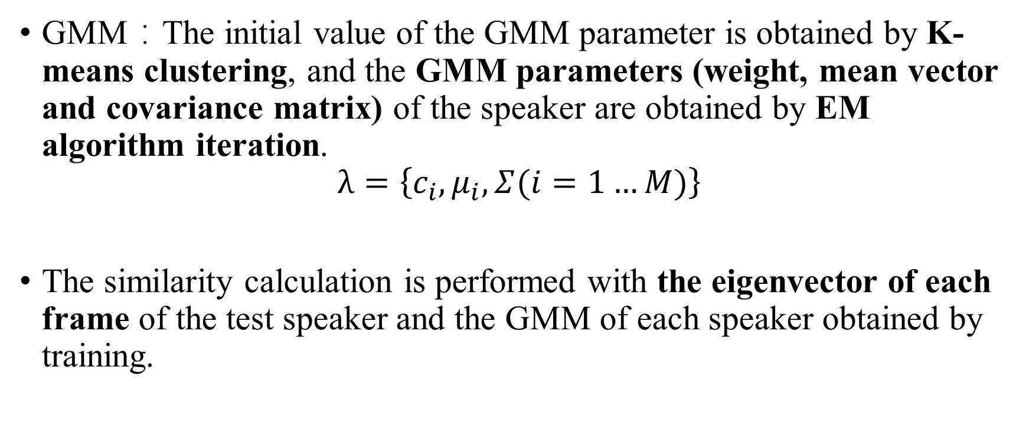
Speaker identification
GMM：The initial value of the GMM parameter is obtained by K-means clustering, and the GMM parameters (weight, mean vector and covariance matrix) of the speaker are obtained by EM algorithm iteration.
$$λ=\left\{c_{i},μ_{i}, Σ(i=1…M)\right\}$$
The similarity calculation is performed with the eigenvector of each frame of the test speaker and the GMM of each speaker obtained by training.
Notes:
之前介绍过利用高斯混合模型进行说话人识别的方法。通过K均值聚类得到GMM参数的初始值，再通过EM算法迭代得到该说话人的GMM参数（权值，均值矢量和协方差矩阵）。
核心是为每一个人训练得到一个GMM混合模型。
在测试阶段，用被测试说话人的语音的每一帧特征矢量与训练得到的每个说话人的GMM进行相似度计算。计算最大后验概率，取对数得分和，判断是哪个说话人。

Slide 6
Result
Test speech feature vector set
Likelihood function calculation
Input voice
Pre-emphasis
Feature extraction
Training speech feature vector set
Model 1 (speaker 1)
Model 2(speaker 2)
K-means clustering
EM algorithm
Model n(speaker n)

Slide 7
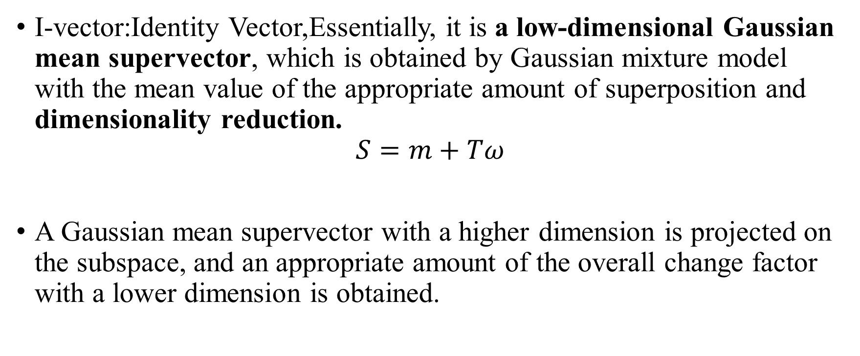
Speaker identification
I-vector:Identity Vector,Essentially, it is a low-dimensional Gaussian mean supervector, which is obtained by Gaussian mixture model with the mean value of the appropriate amount of superposition and dimensionality reduction.
$$S=m+Tω$$
A Gaussian mean supervector with a higher dimension is projected on the subspace, and an appropriate amount of the overall change factor with a lower dimension is obtained.
Notes:
而基于I-vector的说话人识别方法是在基于GMM混合模型的说话人方法上改进得来的。说话人信息和信道信息都涵盖在GMM混合模型中的高维均值超向量上。
I-vector本质上为一个低维的高斯均值超向量，由高斯混合模型各均值适量叠加后降维得到的。
S就是高维的均值超向量，m为与说话人无关且信道无关的均值超向量（UBM）。T为全局差异矩阵，将维数较高的高斯均值超向量在该子空间上进行投影，得到维数较低的总体变化因子矢量w，即为包含整个语音中不同说话人信息和信道信息的全差异因子（w仅含有说话人的信息，表征了说话人的个性特征。），也就是I-vector。

Slide 8
Speaker identification
Each length of speech segment can be represented by a fixed length I-vector.
In the training phase, each speaker is trained to obtain an I-vector. The test phase will test the speaker's speech segment to extract the I-vector feature, and perform similarity calculation with each I-vector obtained by the training to obtain the final identification result.
Notes:
每个长短不一的语音段就可以用一个长度固定的I-vector来表示（维度为400-600） (解决了不同长度语音段特征维度不均衡的问题。)
训练阶段为每段说话人语音训练得到一个I-vector，测试阶段将测试说话人的语音段提取I-vector特征，与训练得到的（每一个I-vector）进行相似度计算，得到最终识别结果。

Slide 9
Training voice
mfcc
GMM
参数估计
T
GMM-UBM
MAP
supervector
I-vector
Testing voice
mfcc
GMM
Similarity calculation
Result
Notes:
T为全差异矩阵。
UBM为与说话人无关且信道无关的由均值超向量构成的通用背景模型。

Slide 10
Deep speaker identification
Common frameworks for deep speaker recognition tasks include DNN/i-vector,CNN,RNN.
CNN:The network structure is based on VGG-M, and some modifications have been made on this basis.
A fully connected layer with a dimension of 9*8 is transformed into a fully connected layer with a dimension of 9*1 and an average pooling layer with a dimension of 1*n.
Notes:
常用语说话人识别的深度学习框架包括深度神经网络与i-vector进行结合，CNN，RNN网络等等。
采用CNN网络用于深度说话人识别的方法的网络结构是基于VGG-M，通过修改网络结构的中间层来实现。
将网络中维度为9*8的全连接层转换为了一个维度为9*1的全连接层和一个维度为1*n的平均池化层。（通过改变n的大小保证网络可以以任意长度的语音作为输入）
（以3s语音长度为例，n等于8。）

Slide 11
input feature
speaker label
convolution1
softmax
max-pooling1
fully-connected7
fully-connected
1*n
convolution2
fully-connected6
9*8
max-pooling2
fully-connected
9*1
convolution3
max-pooling5
convolution4
convolution5

Slide 12
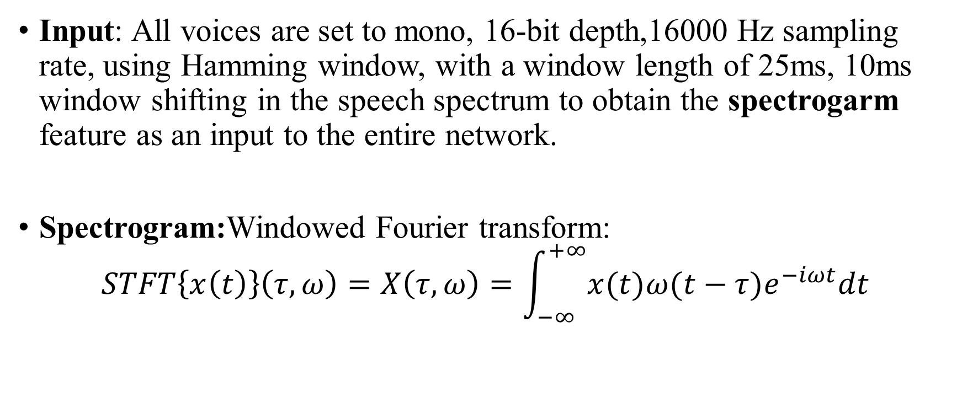
Deep speaker identification
Input: All voices are set to mono, 16-bit depth,16000 Hz sampling rate, using Hamming window, with a window length of 25ms, 10ms window shifting in the speech spectrum to obtain the spectrogarm feature as an input to the entire network.
Spectrogram:Windowed Fourier transform:
$$STFT\left\{x\left(t\right)\right\}\left(τ,ω\right)=X\left(τ,ω\right)=\int_{−∞}^{+∞}{x(t)ω(t−τ)e^{−iωt}dt}$$
Notes:
所有语音设置为单声道，16位深度，16000Hz采样率，采用汉明窗，以25ms窗长和10ms窗移在音频频谱上滑动获得声谱特征（语音的能量谱密度），作为整个网络的输入。
声谱图的获取方法有必要说一下。
加窗傅里叶变换公式如下所示，w为窗函数，x（t）为语音信号。

Slide 13
Deep speaker identification
Each frame of speech is subjected to windowed Fourier transform to obtain a spectrum.
The speech spectrum of each frame is represented by coordinates and rotated by 90 degrees.
Mapping these amplitudes to a gray histogram yields a time-varying spectrogram, which is the spectrogram of the speech signal.
Notes:
每一帧语音进行加窗傅里叶变换得到一个频谱。
将每一帧的语音频谱通过坐标进行表示，然后旋转90度。
将这些幅度映射到一个灰度直方图，得到一个随时间变化的频谱图，就是语音信号的声谱图。

Slide 14
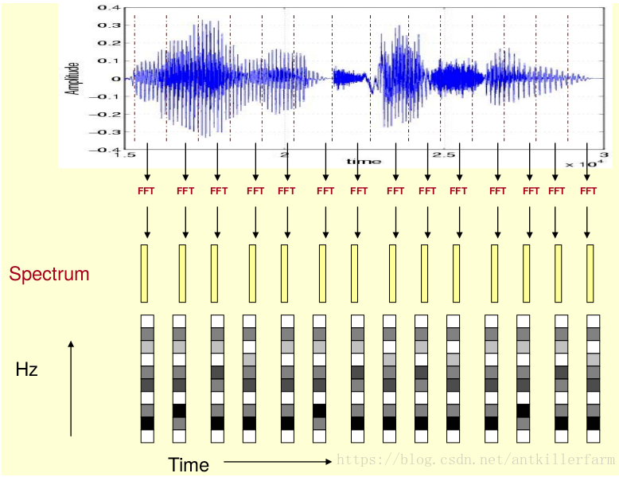
Notes:
最后会得到一个声谱图，也就是一个灰度矩阵，用来作为整个网络的输入。

Slide 15
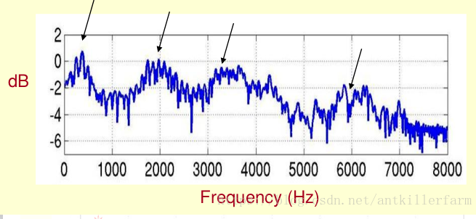
Deep speaker identification
For the spectrogram of speech, the peak value represents the main frequency component of speech, called the formant, and the formant is the identification property that carries the sound.
Notes:
对于语音的频谱图，峰值就表示语音的主要频率成分，称之为共振峰，共振峰就是携带了声音的辨识属性

Slide 16
Deep speaker identification
Output: The output is the score of the speech of and the label information of the corresponding speaker.
Training strategy: Training is based on batch standardization methods, and the required parameters (weight, attenuation, learning rate) are provided by the deep learning toolkit MatConvNet.
Notes:
输出为该段语音的得分和对应说话人的标签信息。
训练是基于批量标准化的方法，所需参数（权重、衰减、学习率）都由深度学习工具包Matconvnet提供。

Slide 17
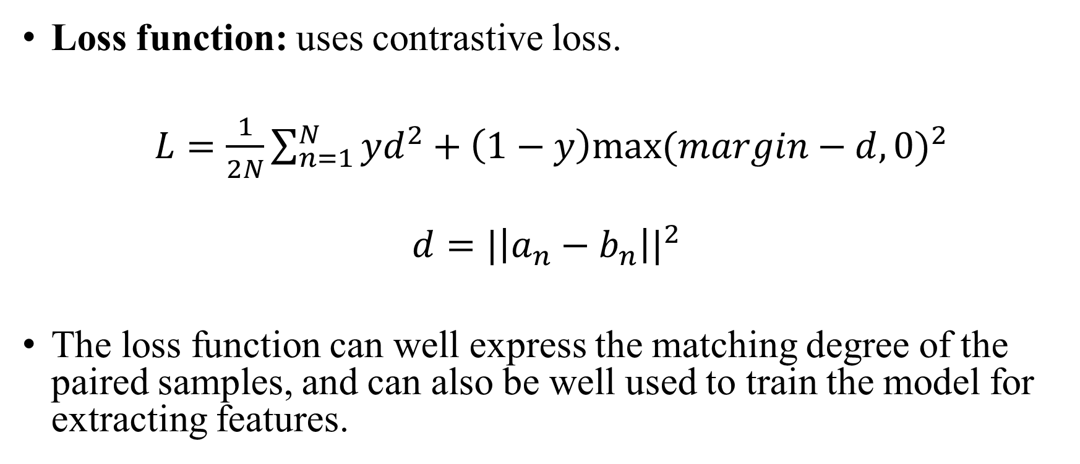
Deep speaker identification
Loss function: uses contrastive loss.
$L=\frac{1}{2N}\sum_{n=1}^{N}{yd^{2}+\left(1−y\right){max⁡(margin−d,0)}^{2}}$
$$d={|\left|a_{n}−b_{n}\right||}^{2}$$
The loss function can well express the matching degree of the paired samples, and can also be well used to train the model for extracting features.
Notes:
损失函数使用对比损失函数.d代表两个样本特征的欧氏距离，y为两个样本是否匹配的标签，y=1代表两个样本相似或者匹配，y=0则代表不匹配，margin为设定的阈值。
该损失函数可以很好的表达成对样本的匹配程度，也能够很好用于训练提取特征的模型。
此外，经常用到的损失函数还有交叉熵损失，中心损失，还有用于深度说话人识别最著名的triplet损失等。

Slide 18
Deep speaker identification
The trained spectrograms is mapped to a compact European space, and the distance metric is used to assess the similarity between speakers.
Identification: Due to the presence of the average pooling layer ,speech of any length can be tested during the test phase and can be evaluated at one time.
Notes:
训练好的语音频谱会映射到一紧凑的欧式空间，通过计算说话人语音特征之间的距离来评估说话人之间的相似性。
在识别过程中，由于平均池化层(维度1*n)的存在，在测试阶段可以测试任意长度的语音，并且可以一次评估。

Slide 19
Thank You

